Slide 1

Parenting in the Age of Screens I – Data Analysis
Data Analysis

Slide 2

Topic Overview
Why I chose this topic
- Hotly debated theme in parenting
- Current pandemic situation
- Parent and children exposure, working from home
and e-learning
Interesting to note that the data was collected in March 2020, around the “start” of the pandemic in the US.
Parents were asked questions about smartphone usage and screen time involving themselves and their children

Slide 3
Dataset Overview
Questionnaire conducted by Pew Research Center (Social and Demographic Trends) in March 2020
3640 Rows (Parents surveyed), 145 columns (surveyed variables) originally but shrank it down to 39 columns
In cases where parents have more than one child in an age range, the parents were randomly assigned to talk about a specific child in the relevant age range
Questions sometimes had sub-parts to narrow down sentiments.
- Ex. Smartphones effect on children’s social skills (1-5), creativity (1-5), etc.

Slide 4
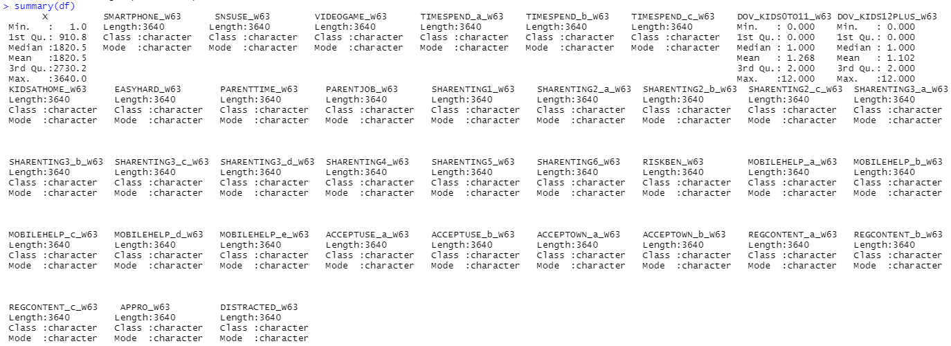
Summary Statistics

Slide 5
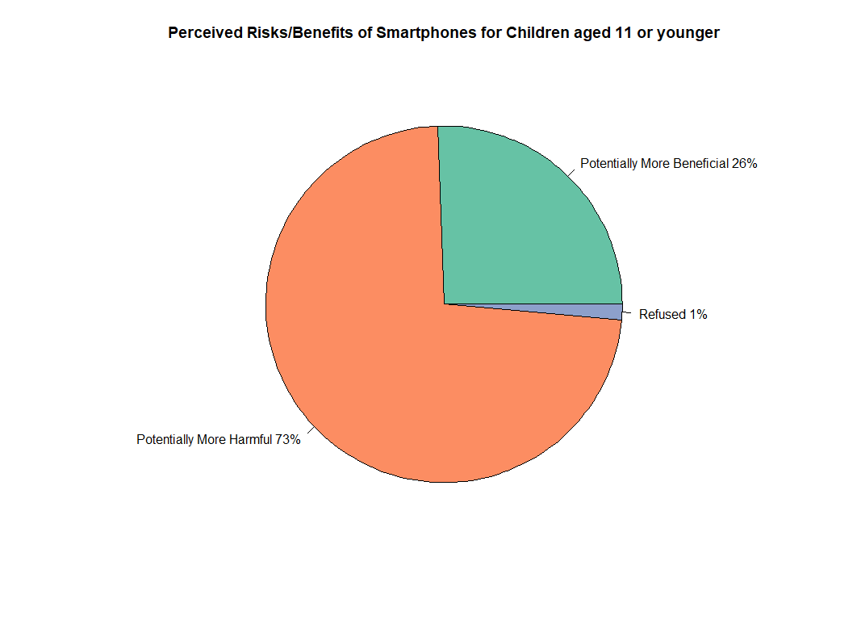
Perceived Risks/Benefits of Smartphones Part 1
Overall sentiment is more harmful, around 73% and 27% beneficial/no difference

Slide 6
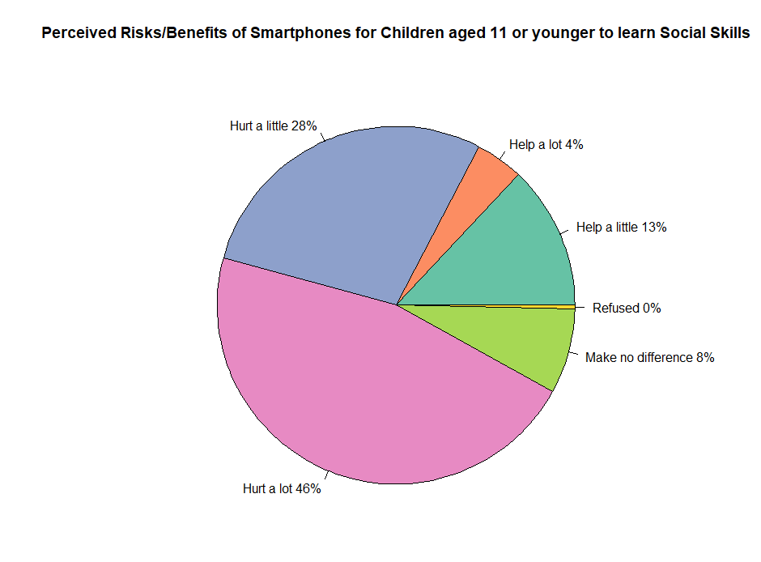
Perceived Risks/Benefits of Smartphones Part 2
Overall sentiment is more harmful, around 74% and 26% beneficial/no difference

Slide 7
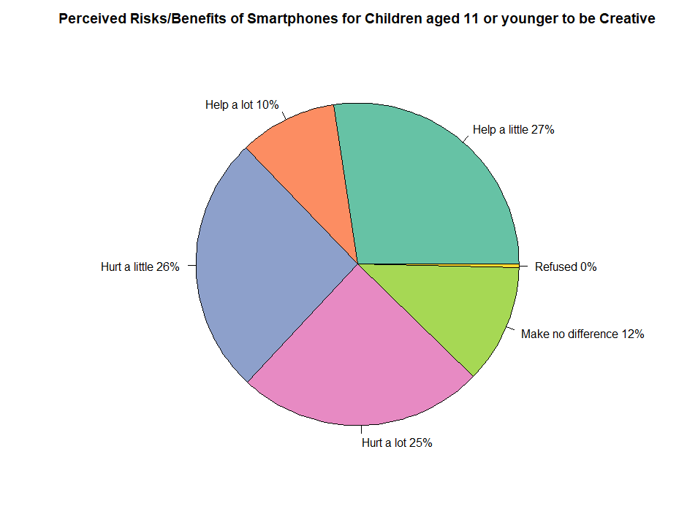
Perceived Risks/Benefits of Smartphones Part 3
Overall sentiment is undecided, around 51% harmful and 49% beneficial/no difference

Slide 8
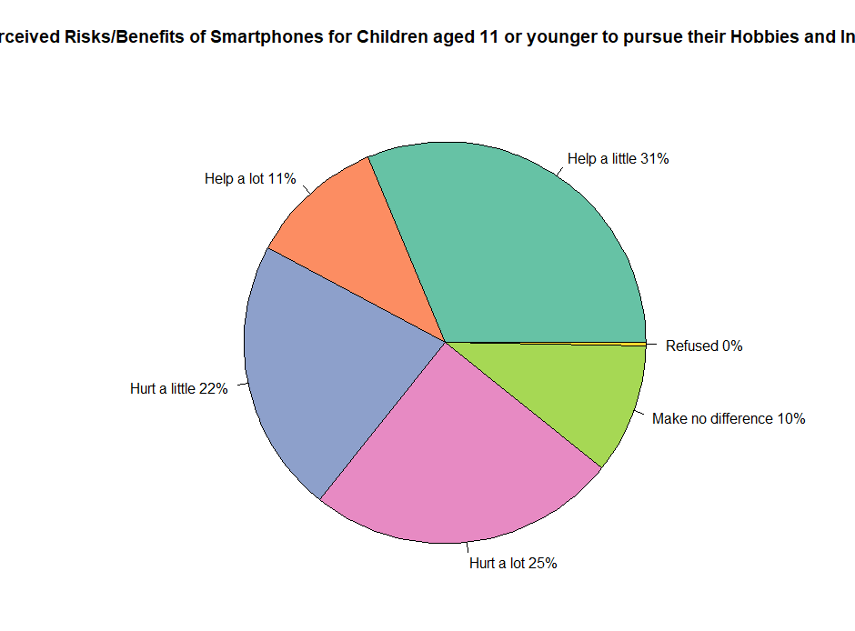
Perceived Risks/Benefits of Smartphones Part 4
Overall sentiment is undecided, around 47% harmful and 53% beneficial/no difference

Slide 9
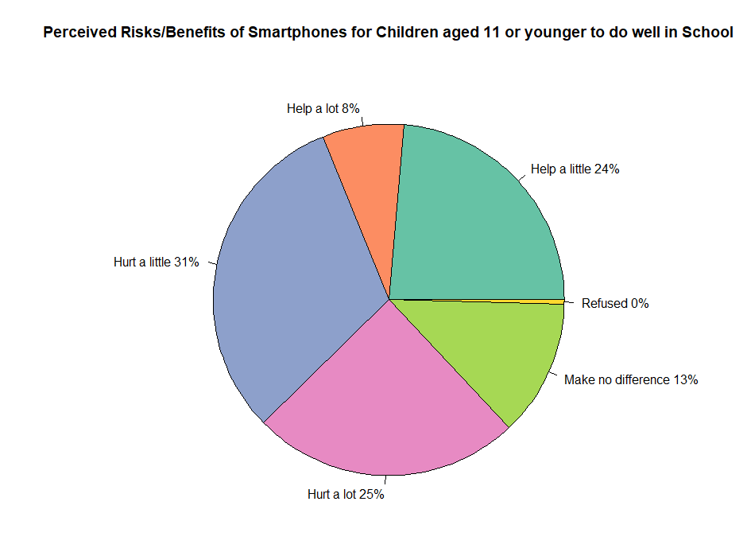
Perceived Risks/Benefits of Smartphones Part 5
Overall sentiment is more harmful, around 56% and 44% beneficial/no difference

Slide 10
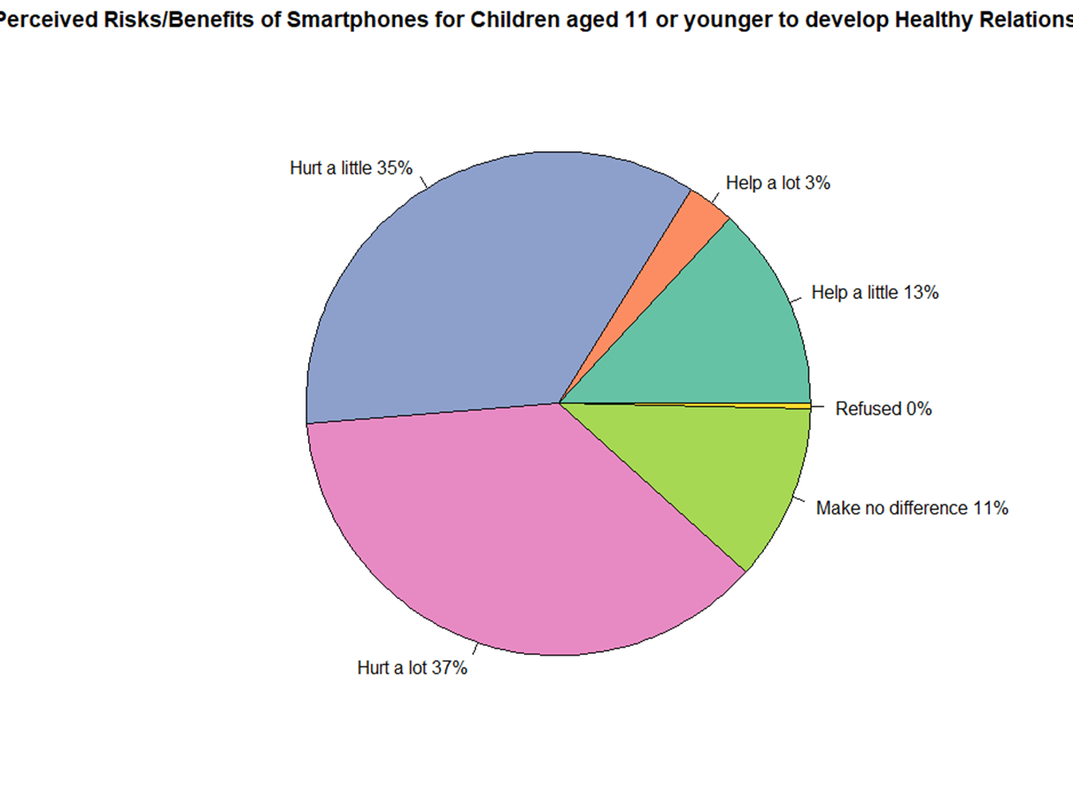
Perceived Risks/Benefits of Smartphones Part 6
Overall sentiment is more harmful, around 72% and 28% beneficial/no difference

Slide 11
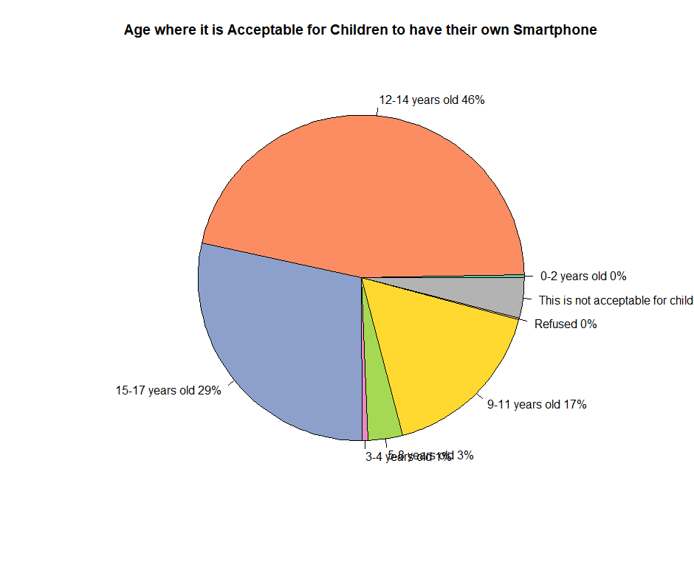

Slide 12
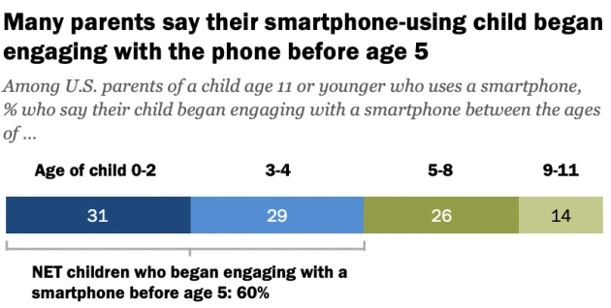

Slide 13
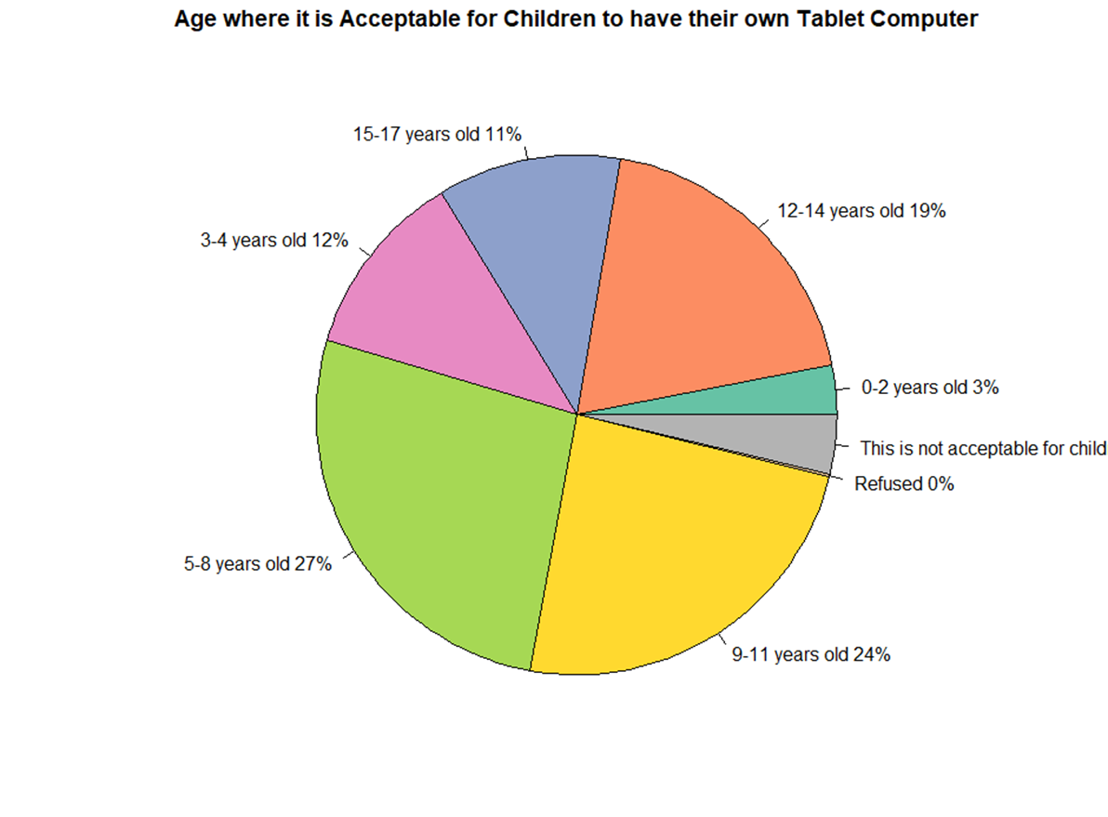
Age acceptable to have own tablet
Overall data was spread out over the children’s ages. Children started using tablets more often after age 5.

Slide 14

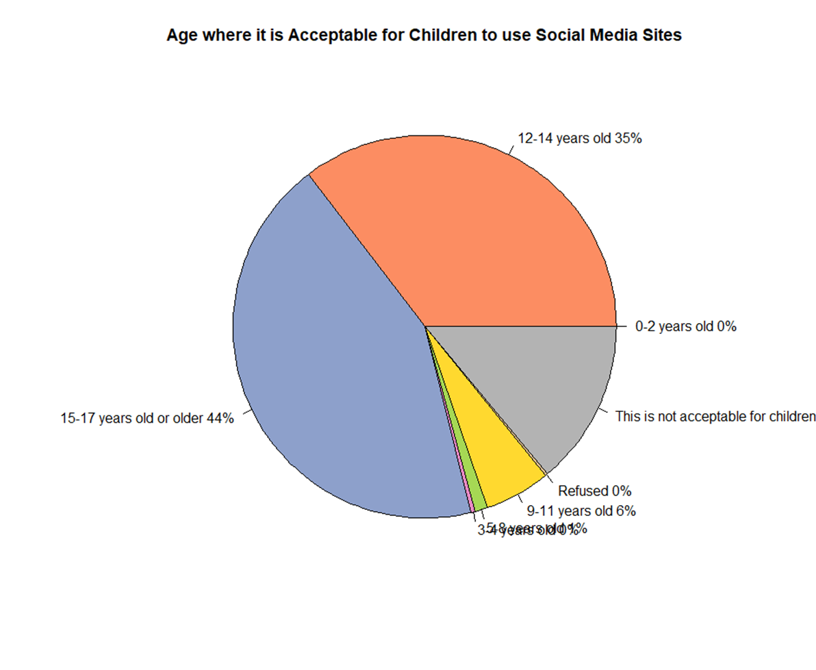
Children’s/
Teens Age and Social Media
Around 79% of children/teens who used social media were 12 or older

Slide 15
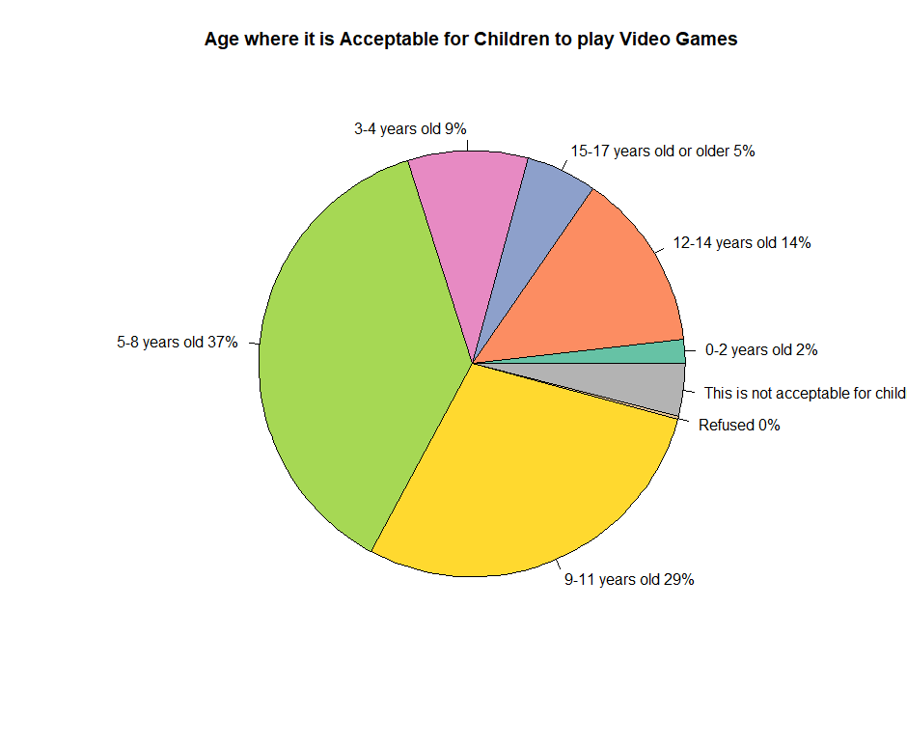
Children’s/
Teens Age and Video Games
Around 66% of children/teens who played video games started between the age of 5-11
Children started playing games at a younger age compared to teens (age 12-17)
Roblox IPO this past week

Slide 16
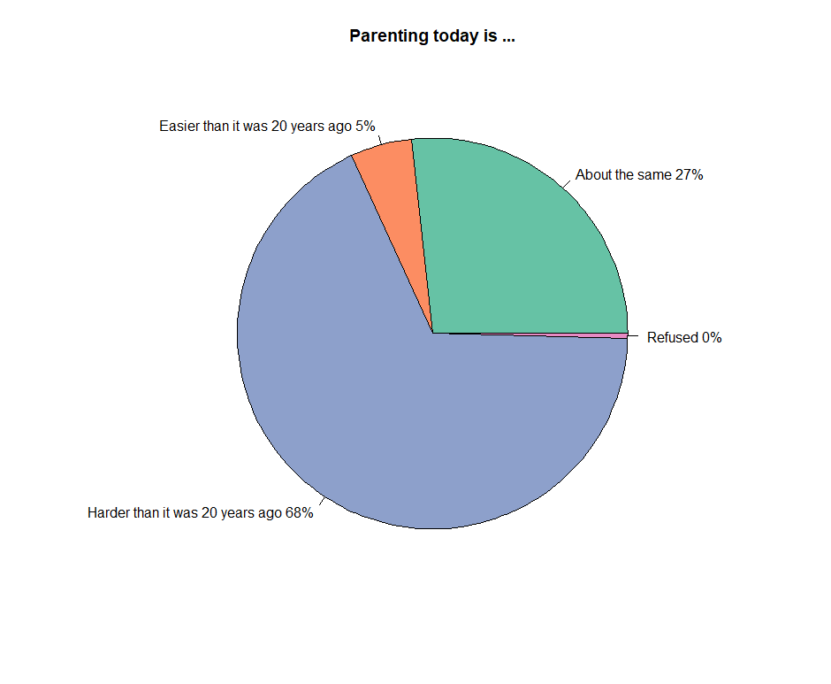
Parenting today …
Majority of parents felt it is more difficult than 20 years ago

Slide 17
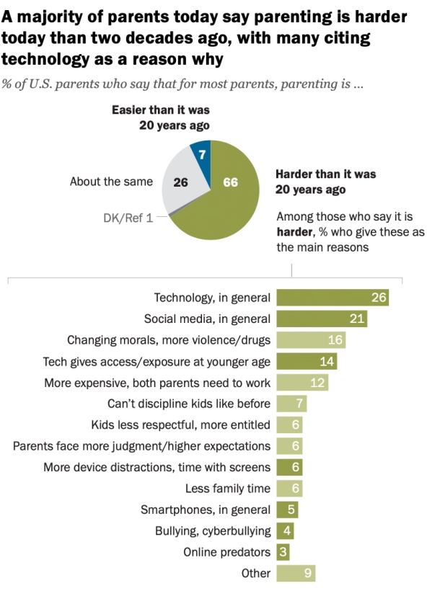
Why parents think it is more difficult to be a parent
Obtained similar results compared my previous pie chart
Reason why was an open-ended question and most parents cited Technology and Social Media

Slide 18
Conclusion
1. Parent’s perception on overall perceived risks/benefits for children’s smartphone use under the age of 11 is negative
2. Parent’s perception on overall age where children should be allowed to have their own smartphone are in their teens (Age 12 to 17), however we saw that more than half of the parents surveyed allowed their children to use a smartphone under the age of 5
3. Social Media usage is prevalent among teens (aged 12 and older)
4. Age where children began playing video games is prevalent among kids (aged 12 and younger)
5. Parent’s sentiments are that it is more difficult to be a parent today than 20 years ago due to technology and social media

Slide 19
Thoughts and Improvements
Data from the studies of child psychologists on smartphone usage
Technology usage in the pandemic for children
Felt it was difficult to do predictive analytics on data provided
Plan to add logistical regression comparing household income to a child’s smartphone usage

